Slide 1
Data Hiding using Image Steganography
Major Project- I
Group no. : 30
Group Members : Ankush Kashyap(181202), Parul Damalu(181454)
Proficiency : Information Security
Project Supervisor : Dr. Kapil Sharma
Notes:
We designed this template so that each member of the project team has a set of slides with its own theme. Members, here’s how you add a new slide to just your set:
Mark where you want to add the slide: Select an existing one in the Thumbnails pane, click the New Slide button, then choose a layout. The new slide gets the same theme as the other slides in your set.
Careful! Don’t annoy your fellow presenters by accidentally changing their themes. That can happen if you choose a different theme from the Design tab, which changes all of the slides in the presentation to that look.

Slide 2


Introduction: Data Hiding
Embedding data or information in digital data so that it cannot be visually or audibly perceived.

Slide 3
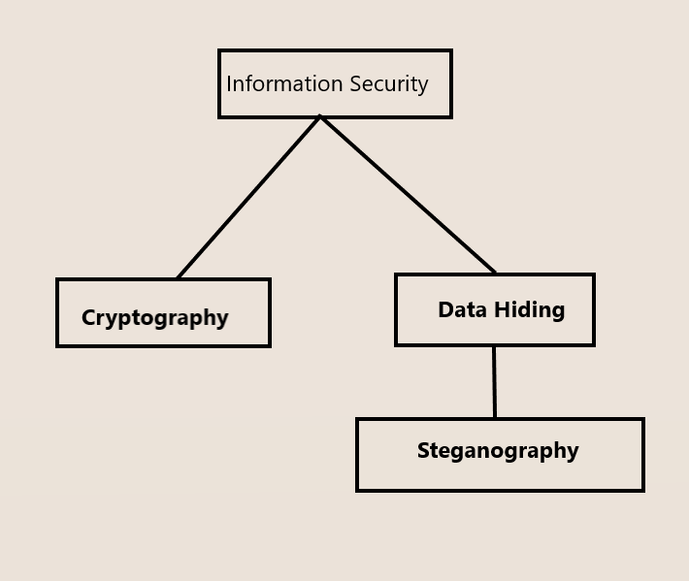
Data Hiding and Cryptography
Cryptography : Conversion of the secret message to human readable form.
Data Hiding: Technique to hide the existing data.

Slide 4
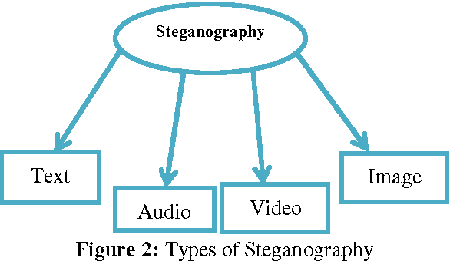
Steganography and its Types
Steganography is a method of hiding secret data, by embedding it into an audio, video, image, or text file.

Slide 5
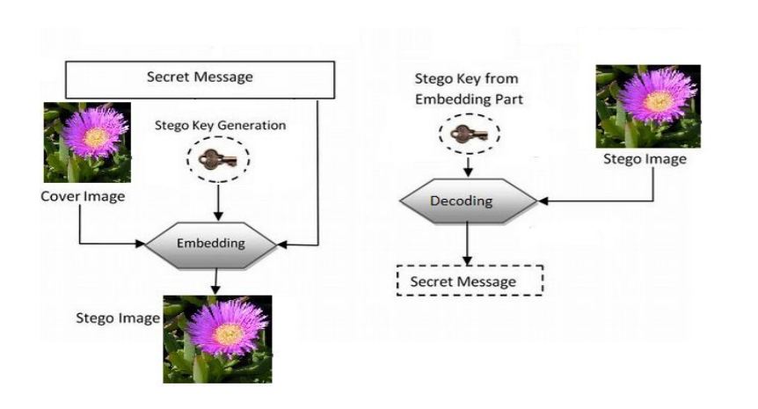
Steganography Model

Slide 6
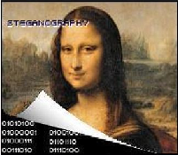
Applications of Steganography
1. Secret data storing.
2. Protection of data from being altered.
3. Watermarking.

Slide 7
Libraries Used
Numpy
PIL
Tkinter
Cv2 (OpenCV)

Slide 8
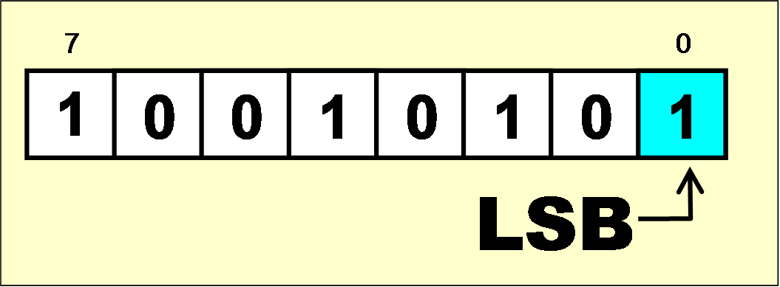
LSB Algorithm for Image Steganography
LSB stands for Least Significant Bit. The idea behind LSB embedding is that if we change the last bit value of a pixel, there won’t be much visible change in the color. For example, 0 is black. Changing the value to 1 won’t make much of a difference since it is still black, just a lighter shade.

Slide 9

Steps involved in LSB- “ENCODING”
Step 1- Get the Pixels (RGB) of the input image in which we will be hiding the secret message.
Step 2- Find the ASCII value of every character of the secret message. And convert that ASCII value to the corresponding binary number.
For e.g. We want to hide the letter H in our picture. So H has 72 ASCII value. So the 8 bit- binary representation of 72 will be

Slide 10
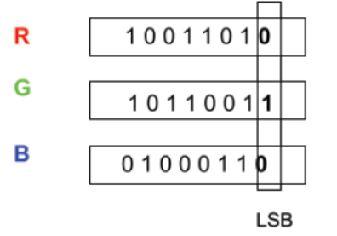
Step 3- So the next task is to add the every single bit of the binary representation of the message characters to the Least significant bit of the Pixel values.
Step 4- So finally after inputting every bit of the hidden message in the least significant bit of pixel values, finally we will be getting a “Stego” image that is image having secret data inside it which we will forward to the receiver.

Slide 11
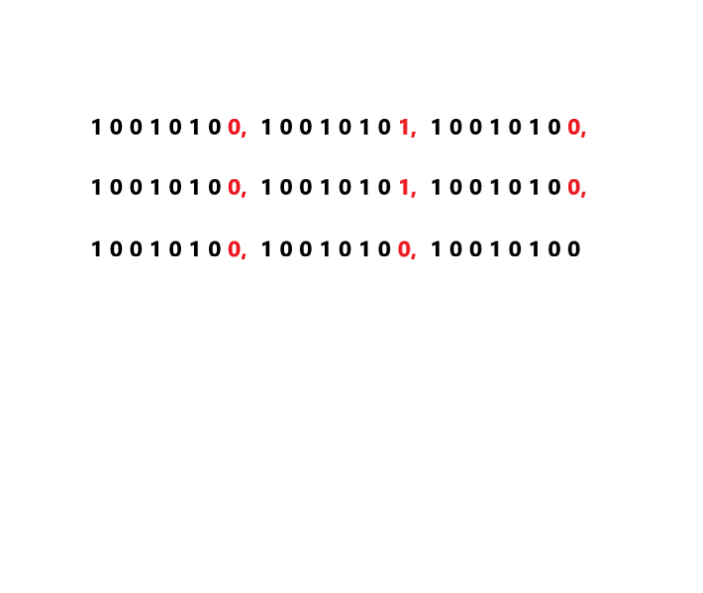
Decoding in LSB algorithm
Step 1- When the receiver will receive the Stego image , he will covert that image into array of pixels and find the binary representation of every pixel.
For e.g. Hidden text is H and H’s binary bits will be at LSB of Stego pixels.
Red colored 0s and 1s are the bits of the secret message i.e. H.

Slide 12
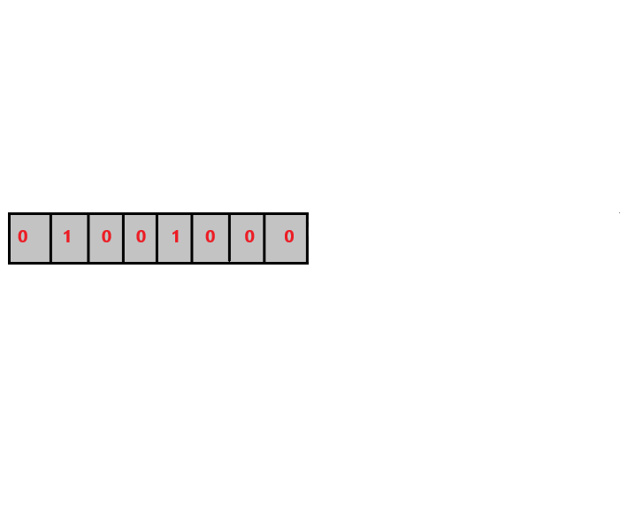
Step 2- Now the We will extract the LSB of the Stego image pixels and put them in an array or 1D list and find the decimal number of that 8 bit binary bits. This decimal number will give us the ASCII value of the Message bits. And the corresponding character to the ASCII value will be displayed, which will be out hidden or the secret message
DECIMAL : 72 ASCII value 72 : “H”

Slide 13
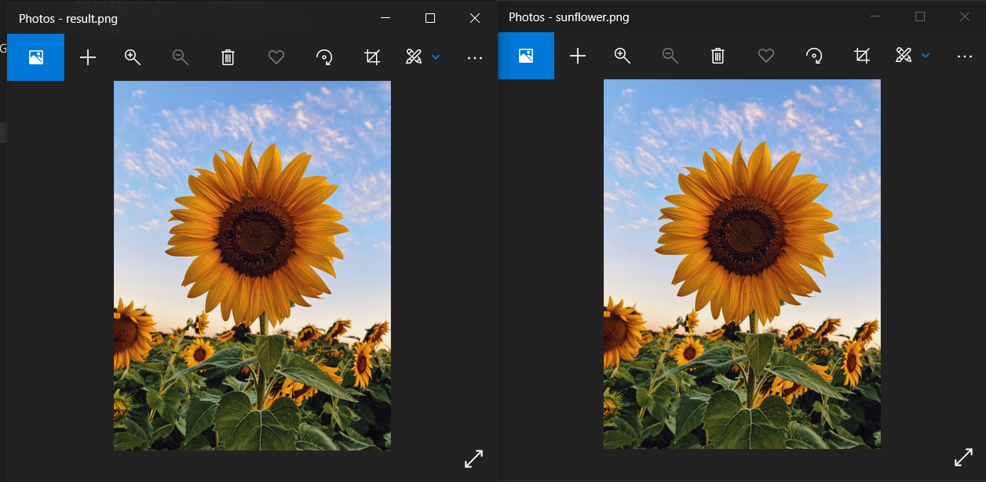
LSB Steganography Advantages
Data embedding is simple and easy.
It is almost impossible to detect changes done in the actual image. Doesn’t Changes the size of file i.e. Lossless Decomposition.
Secret message: “HIL”
Original
Image

Slide 14
LITERATURE REVIEW
Data hiding is one of best topic in secret communication. LSB Steganography technique does not effect the properties like size and pixels of original image and the changes are not visible as it is lossless decomposition. Secrets can be hidden in all types of medium: text, audio, video and images. Steganography is an important area of research in recent years involving a number of applications.
Steganography can be used in supplementary to cryptography, watermarking and fingerprinting. Steganography can be used to conceal and transfer an encrypted document containing some acquired information in military applications.
Another application area concerns the invisible storage of confidential data . The secure storage of sensitive private data such as credit card numbers, bank accounts, passwords, etc. can benefit from data hiding technologies.
There are various future scopes of the image steganography, Efforts can be made to hide text files having more size than image size. Steganography with Cryptography will together be an unbeatable tool for secure communication.

Slide 15
References
Arun Kumar Singh, Juhi Singh , Dr. Harsh Vikram Singh, “Steganography in Images Using LSB Technique”_ https://www.ijltet.org/wp-content/uploads/2015/02/60.pdf -
2. VIPrefect_Application_Areas _http://www.viprefect.com/application-areas

